Slide 1

Chapter 6
Functions

Slide 2
Content
Built-in functions
The function machine and the purpose of functions
Syntax and naming conventions
Functional definition
Functional call
Using built-in features
Default values for parameters
Documentation
Function returning a sequence
Testing function via assert

Slide 3
Built-in functions
In the previous chapters, we have made extensive use of built-in functions in Python such as:
print()
input()
int() - str() - float()
range()
len()
list() - tuple()
All these functions generate an output based on a certain input.
The purpose of this chapter is to program such functions.

Slide 4
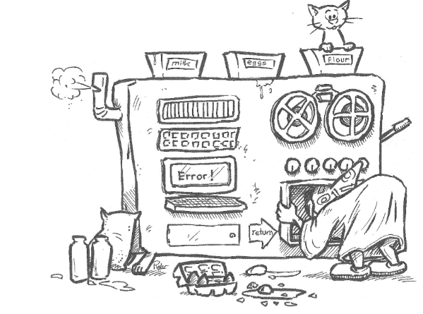
The function machine
A function is a large machine that, for example, bakes pancakes.
input: milk, eggs, flour
output: Pancakes
BUT depending on the flour you use you get buckwheat pancakes, whole wheat pancakes, yeast pancakes, ...
Suppose a cat is twisted through the flower, then the machine generates an 'Error!
Big advantage: even if you don't know how to bake pancakes, the machine will still deliver a pancake as long as you provide the right ingredients!
Source: Spronck P. , De programmeursleerling: leren coderen met Python 3, 2017-10-24

Slide 5
The purpose of functions
Encapsulation or the blackbox principle
Packing a useful piece of code in such a way that it can be used without knowledge of the specific operation of the code.
~ you don't have to be able to bake a pancake, and yet one comes out.
Generalization:
Making a piece of code suitable for various situations by using parameters
~ depending on the type of flour, the machine bakes whole wheat or buckwheat or ... pancakes
Reusability:
Every time you need the same functionality, you can call on the function that has already been worked out.
~ the pancake machine is used over and over again

Slide 6
The purpose of functions
Controllability:
Functions allow you to divide a program into small, easy-to-understand parts. You split the complex program into several sub-problems.
Maintainability:
When functions are given clear, meaningful names, the program that uses these functions becomes more readable and understandable to other programmers.

Slide 7
Creating a function
def name_function(parameter, ...):
actions
Keyword def defines a function
A function has a name
A function has zero or more parameters
Names of parameters are in round brackets and are separated by a ,
Data type of parameters is not defined
A function performs a number of actions, this lines of code must be indented
For example:
def squared_sum(a, b): sum = a + b return sum ** 2

Slide 8
Naming conventions function
Function names must meet the same requirements as variable names.
Only letters, numbers and underscores are allowed.
Names may not start with a digit.
Separate words are separated by an underscore.
Function names should be clear and meaningful.

Slide 9
2 types of functions
Functions that directly perform an action and therefore do not need to return a result. A possible action is, for example, printing results.
Functions that perform a calculation or a check and return the result to the main program. The return of the result is done with a return instruction.

Slide 10
Function definition: examples
Function show_double(value) prints the double of the parameter value
Function double(value) returns double the parameter value
def show_double(value): print(value * 2)
1 parameter
no return
def double(value): return value * 2
1 parameter
return of a number

Slide 11
Function definition: examples
Function maximum(number1, number2) returns the largest of the two parameters
You can also write the function as follows:
def maximum(number1, number2): if number1 > number2: return number1 else: return number2
2 parameters
return of the largest number
def maximum(number1, number2): if number1 > number2: return number1 return number2

Slide 12
Function definition: examples
Function square_is_smaller(number1, number2) returns whether the square of number 1 is smaller than number 2.
Written differently
def square_is_smaller(number1, number2): if number1 ** 2 < number2: return True else: return False
2 parameters
return of a boolean value
def square_is_smaller(number1, number2): return number1 ** 2 < number2

Slide 13
Function definition: examples
Function triangle_type(a, b, c) returns the type of triangle you can form with the three parameters
def triangle_type(a, b, c): if a == b and b == c: return 'equilateral triangle' elif c ** 2 == a ** 2 + b ** 2: return 'right triangle' else: return 'other triangle'
3 parameters
return of a string giving the type of triangle

Slide 14
Functional call
The function must be defined in the program before it can be used!
The parameter value in the function gets the content of the argument in the function call.
# function definition def show_double(value): print(value * 2) # main program with function call number = 3 show_double(number)
function
value
int
3
main programme
number

Slide 15

Function call: example
Function show_double(value) prints the double of the parameter value
# function definition
def show_double(value): print(value * 2)
# main program with function call show_double(2) show_double('la') show_double([1, 2, 3])
The function is called here. The parameter value in the function is always given the content of the argument in the function call. value = 2
value = 'la'
value = [1,2,3]
Since the data type of the parameter is not fixed, you may pass integers, strings, lists, ....

Slide 16

Function call: example with return
Function double(value) returns double the parameter value
# function definition def double(value): return value * 2 # main program with function call twice = double(15) print(twice) print(double('ho'))
First option: the returned result is captured in a variable and then used in the main program.
Second option: the returned result is immediately used in the main program.

Slide 17

Function call: example with 2 parameters
Function maximum(number1, number2) returns the largest of the two parameters
def maximum(number1, number2): if number1 > number2: return number1 else: return number2 print(maximum(37, 25)) print(maximum(1, 16)) print(maximum(10, 10))
the returned result is immediately used in the main program.

Slide 18

Scope or range of variables
Variables used to define a function are only known in the function.
In the main program you can't address these variables (black box principle)
# function definition def double(value): return value * 2 # main program with function call number = 3 print(double(number)) print(value)
function
value
int
3
mainorgrogram
number

Slide 19
Scope or range of variables
Variables in a function have a very limited lifetime.
After all, they are only usable during the execution of the function.
After the execution of the function, these variables are immediately deleted out of the memory.

Slide 20
Load built-in functions via import
from math import sqrt number = int(input('Enter an integer: ')) if number < 0: print('Square root of a negative number does not exist!') else: print('Square root of', number, 'is', sqrt(number))
The sqrt function is provided through the class math. Other functions from class math are for example pow(), ceil(), floor(), sin(), cos(), ...

Slide 21
Function roll_dice()
from random import randint def roll_dice(number_dice): total = 0 for counter in range(0, number_dice): total += randint(1, 6) return total
This function simulates the rolling of one or more dices and returns the total number of the pips. The function parameter indicates how many dices are used.
The built-in function randint(lower limit, upper limit) is used. This function generates a random integer between lower limit and upper limit (included). randint(1,6) generates a number from 1 to 6.

Slide 22

Call roll_dice()
from random import randint def roll_dice(number_dice): total = 0 for counter in range(0, number_dice): total += randint(1, 6) return total # Main program with function call attempts = 1 while roll_dice(2) != 12: attempts += 1 print('After', attempts, 'attempts you rolled 12.')
This function is used to calculate how many attempts you need to roll 2 dices to reach the maximum number of 12 pips.

Slide 23
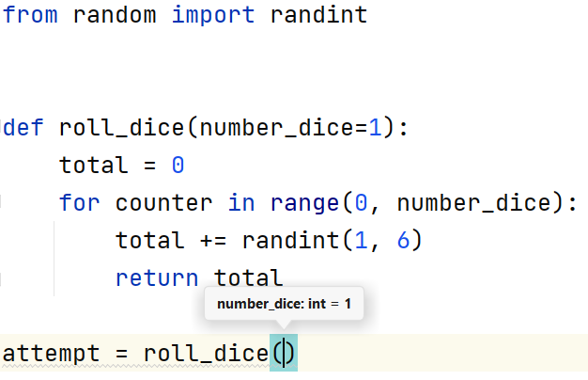
Default values for parameters
In the definition of a function, you can add a default value to your parameters.
When calling the function, you do not have to give a value for that parameter. The default value is used automatically.

Slide 24
Default values for parameters
In the function call, you can decide to enter a value that will overwrite the default value.
def roll_dice(number_dice=1): total = 0 for counter in range(0, number_dice): total += randint(1, 6) return total # Main program with function call attempts = 1 while roll_dice(2) != 12: attempts += 1 print('After', attempts, 'attempts you rolled 12.')

Slide 25
Documentation
In order to make the re-use of a function by others possible, you need to describe very clearly how the function works.
Python provides a documentation string you can include in the definition of the function. This documentation is put between """ """
def roll_dice(number_dice=1): """ This function simulates rolling one or more dice. :param number_dice: integer that indicates the number of dice used :return: the number of pips rolled """ total = 0 for counter in range(0, number_dice): total += randint(1, 6) return total

Slide 26
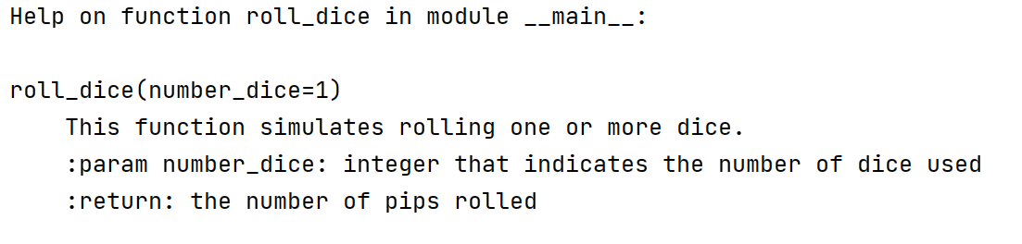
Documentation
Via the built-in function help() you can retrieve the documentation string.
Result
help(roll_dice)

Slide 27
Function returning a List
We change the function roll_dice() so that it does not return the total number of pips but a list containing the number of pips on each stone.
from random import randint def roll_dice(number_dice=1): """ This function simulates throwing one or more dice. :param number of_dice: integer that indicates the number of dice used :return: a list with the number of pips on each stone. """ list_pips_rolled = [] for counter in range(0, number_dice): list_pips_rolled.append(randint(1, 6)) return list_pips_rolled

Slide 28
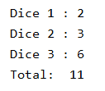
Function returning a List
from random import randint
def roll_dice(number_dice=1): """ """ list_pips_rolled = [] for counter in range(0, number_dice): list_pips_rolled.append(randint(1, 6)) return list_pips_rolled # Main program with function call pips = roll_dice(3) total = 0 for i in range(0, 3): print('Dice', i + 1, ':', pips[i]) total += pips[i] print('Total: ', total)

Slide 29
Testing functions with assert
Before making a function available, you need to be 100% sure that this function works correctly in all possible situations.
Until now, we tested our function by manually calling it up again and again with changing arguments and checking the output.
You can automate this manual process with an assert-statement.
If the boolean expression is True, the code continues.
If the boolean expression is False, the code stops with an AssertionError
assert boolean expression
assert len(roll_dice()) == 1

Slide 30
Testing roll_dice()
Example: this function returns a list with the number of pips per stone.
We test whether x elements are returned when throwing x stones.
We test if the total does not exceed the maximum
assert len(roll_dice()) == 1 assert len(roll_dice(5)) == 5 assert len(roll_dice(0)) == 0 assert len(roll_dice(-3)) == 0
assert sum(roll_dice()) >= 1 assert sum(roll_dice()) <= 6 assert sum(roll_dice(2)) <= 12

Slide 31

Testing roll_dice()
If the test fails, the code stops.
For example, it would be better that the function returns the keyword None when the user passes 0 or a negative number as an argument for number_stones.
If we test for this now, we'll get an Assertion Error
assert roll_dice(0) == None assert roll_dice(-3) == None
The None keyword is used to define a null value, or no value at all. None is not the same as 0, False, or an empty string.
None is a data type of its own (NoneType) and only None can be None.

Slide 32
Testing roll_dice()
We can solve the AssertionError by modifying the definition of the function:
import randint from random def roll_dice(number_dice=1): """ This function simulates throwing one or more dice. :param number of_dice: integer that indicates the number of dice used :return: a list with the number of pips on each stone. """ if number_dice <= 0: return None else: list_pips_rolled = [] for i in range(0, number_dice): list_pips_rolled.append(randint(1, 6)) return list_pips_rolled

Slide 33
Testing roll_dice()
We continue to improve the function: what should happen if no integer is entered as an argument in the function call?
def roll_dice(number_dice=1): """ """ if type(number_dice) != int or number_dice <= 0: return None else: pips_rolled = [] for i in range(0, number_dice): pips_rolled.append(random.randint(1, 6)) return pips_rolled assert roll_dice(2.5) == None

Slide 34
How do you test in PyCharm?
Write your function definition
Do not write a main program (yet) but replace it with a number of asserts with which you can test the function.
If your function works correctly, you can continue coding.
def maximum(number1, number2): if number1 > number2: return number1 return number2 assert maximum(15, 6) == 15 assert maximum(-3, 6) == 6 assert maximum(4, 4) == 4

